Slide 1


AI-Powered Surveillance System for Real-Time Anomaly Detection
Using YOLOv8, OpenCV & Streamlit Dashboard
Presented By
24KN1A0507 :Gayathri A
24KN1A0539 : Aashritha B
24KN1A0511 : Bhanu sri A
24KN1A0524 : Mahesh B
Guided By
Mr. M.V.P Umamaheshwar Rao Sir
Department of Computer Science & Engineering

Slide 2
ABSTRACT
‹#›
The rise in urban crime rates and the shortcomings of conventional monitoring techniques have led to a sharp surge in the need for automated and intelligent surveillance systems in recent years. This study presents a smart surveillance and crime detection system that uses deep learning and artificial intelligence (AI) to identify illegal activity in real time. The system incorporates a number of sophisticated models, including Convolutional Neural Networks (CNNs) for behavioural analysis, Insight Face for facial recognition, and YOLOv8 for weapon and object identification. By comparing live video feeds from security cameras to a criminal database, it can detect faces, track human activity, and identify suspect things. The technology notifies the relevant authorities in real time when it detects abnormalities like weapons, known criminals, or violent conduct. This proactive approach seeks to enhance public safety, assist law enforcement, and lower crime rates. The system showed great accuracy and low latency when tested on public datasets and sample footage, suggesting that it might be implemented in actual security systems.

Slide 3
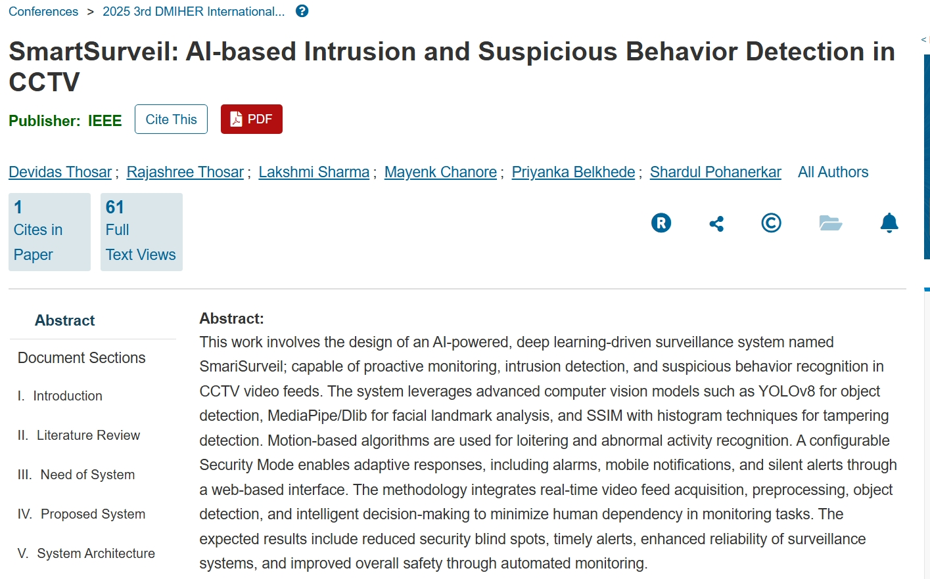
BASEPAPER
Authors
Harsh K. Dave
CSE, PIET, Parul University, Vadodara, India
Sparsh J. Pathak
CSE, PIET, Parul University, Vadodara, India
Kamal Sutaria
Department of CSE, PIET, Parul University, Vadodara, India Published In
2025 IEEE 6th International Conference on Image Processing, Applications and Systems (IPAS)
Motivation for Our Project
This paper inspired our work by demonstrating how Artificial Intelligence and Computer Vision can automate surveillance systems. Our project focuses on lightweight anomaly detection using YOLOv8 and OpenCV.

Slide 4
OBJECTIVES
‹#›
Primary Objective
Develop an intelligent surveillance system for real-time anomaly detection.
Specific Objectives
Detect persons and objects.
Track detected objects.
Identify loitering.
Detect abandoned objects.
Generate real-time alerts.
Store screenshots and logs.
Visualize incidents through a dashboard.

Slide 5
Gap Analysis
Existing Research / System | Identified Gap | Proposed Solution
Traditional CCTV systems only record footage. | No automatic detection of suspicious activities. | AI-based real-time anomaly detection.
Human operators continuously monitor cameras. | Human fatigue can lead to missed incidents. | Automated monitoring using YOLOv8.
Many surveillance systems focus only on object detection. | Lack of behavioral analysis. | Detect loitering and abandoned objects.
Alerts are often generated after manual review. | Delayed response to incidents. | Instant real-time alert generation.
Large amounts of video data are difficult to analyze. | Time-consuming investigation process. | Automated event logging and dashboard visualization.
Advanced surveillance solutions are expensive. | Limited accessibility for educational and small-scale deployments. | Cost-effective solution using open-source tools.

Slide 6
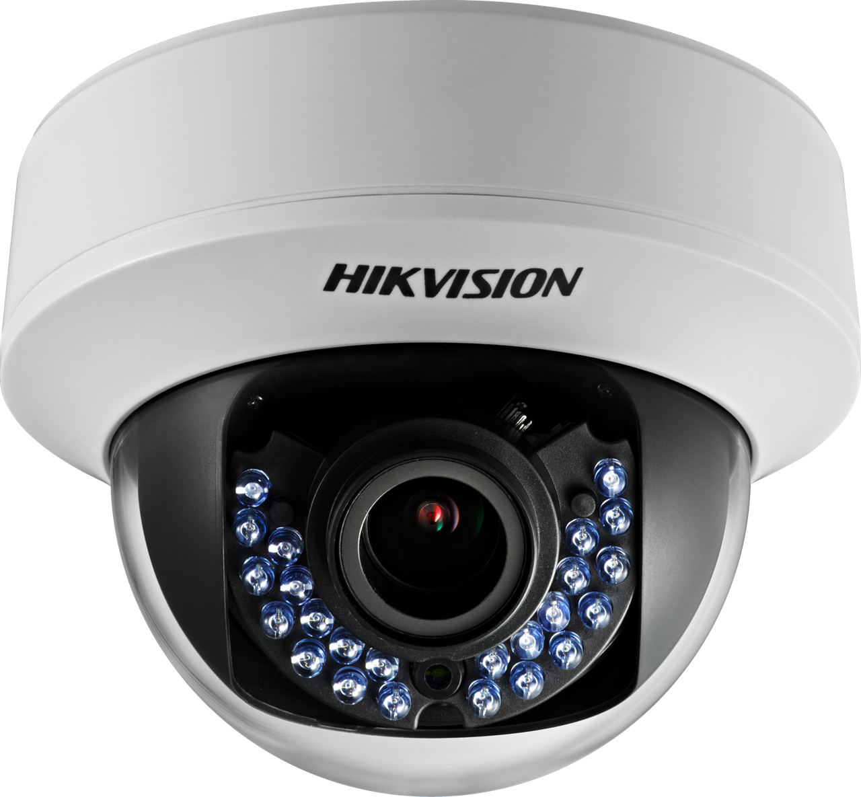
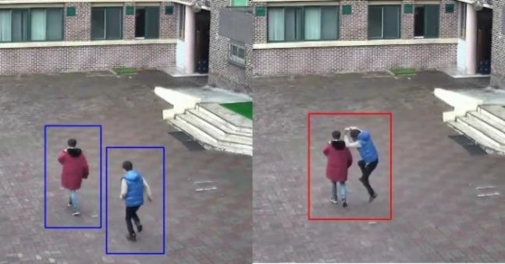
Problem Statement To develop an AI-powered surveillance system capable of automatically monitoring CCTV footage and detecting suspicious activities in real time.
Proposed System Architecture
Video Input
↓
OpenCV Frame Processing
↓
YOLOv8 Object Detection
↓
Object Tracking
↓
Anomaly Detection
• Loitering Detection
• Abandoned Object Detection
↓
Alert Generation
↓
CSV Logging
↓
Streamlit Dashboard
This Photo by Unknown Author is licensed under CC BY-NC-ND

Slide 7
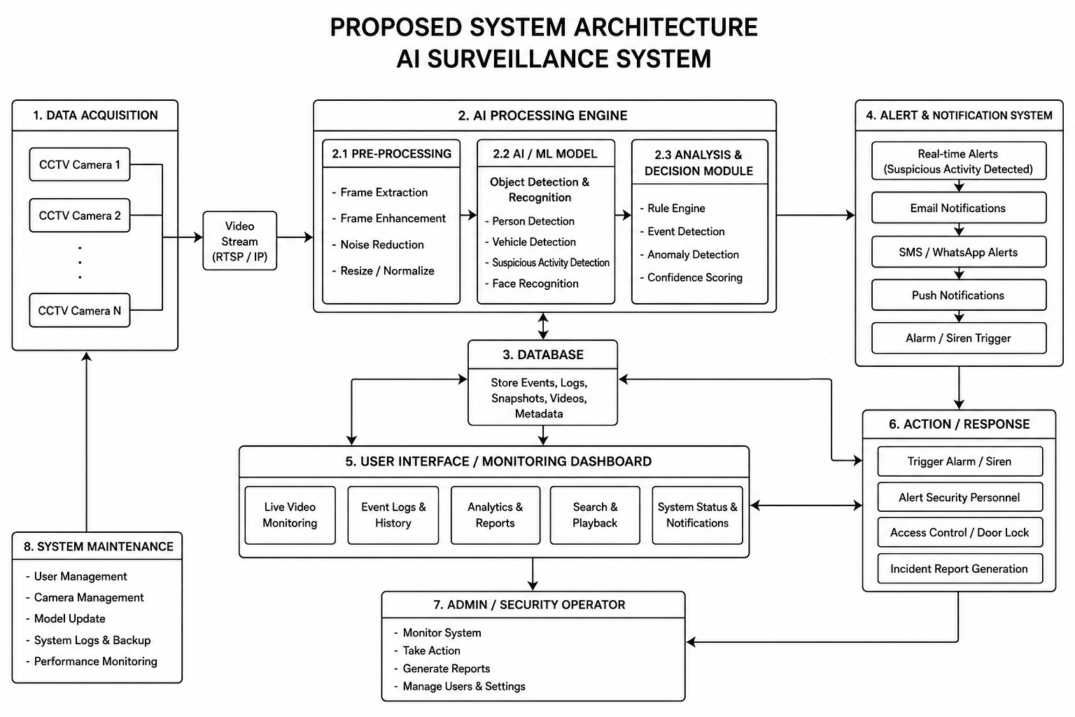

Slide 8
TECHNOLOGIES USED
Technology | Purpose
Python | Core Programming
OpenCV | Video Processing
YOLOv8 | Object Detection
PyTorch | Deep Learning Framework
Streamlit | Dashboard Development
CSV | Alert Logging

Slide 9
CONCLUSION
Detects suspicious activities and objects in real time using *YOLO* and*OpenCV*.
Minimizes human intervention through automated monitoring and instant alerts.
Enhances security with faster, more accurate, and reliable threat detection.
Provides a scalable and cost-effective solution for smart surveillance applications.
Future Scope: Integrate facial recognition, cloud-based analytics, multi-camera tracking, and predictive AI to build a next-generation intelligent surveillance system.
“AI-powered surveillance is not just about watching—it's about understanding, predicting,and responding to security threats in real time.”

Slide 10
Thank You

